Slide 1
Come in Quietly
Take out your whiteboard & pen.
Take out a piece of paper, pen or pencil.
Have your chromebook ready to use but do not open yet.
Immigration

Slide 2


Immigration! What is it and why do it?
Objective
Obj: Describe different types of immigrants and list the push/pull factors that brought them to the United States.
Learning Targets:
1. I will be able to explain the difference between
immigrant, emigrant, and migrant.
2. I will be able to describe the major push-pull
factors for immigration.
Standard 8.6.3: List the reasons for the wave of immigration from Northern Europe to the United States and describe the growth in the number, size, and spatial arrangements of cities (e.g., Irish immigrants and the Great Irish Famine.)
CCSS.ELA-LITERACY.RH.6-8.4:Determine the meaning of words and phrases as they are used in a text, including vocabulary specific to domains related to history/social studies.

Slide 3

Prior Knowledge
Prior Knowledge
You already know the difference between an immigrant, emigrant and migrant.
What is an example of each type of immigration?

Slide 4

Definitions
Concept
Push Factor - are those things that encourage a person to leave their home.
Pull Factor - something that attracts people to go and live in a particular place.

Slide 5
Push/Pull Factors
Concept
Step 1 - Brainstorm Ideas
on your paper.
Step 2 - Share with Partner.
Step 3 - Be ready to share
with the class.
If you decided to move away from Ceres what are some of the reasons you would leave? Where would you go and why would you choose that place?
Partner A share with Partner B “If I decided to leave Ceres I would go to _______ because _______”.
Partner B share with Partner A “If I decided to leave Ceres I would go to _______ because _______”.

Slide 6
Push/Pull Factors
Concept
Step 1 - Brainstorm Ideas
on your paper.
Step 2 - Share with Partner.
Step 3 - Be ready to share
with the class.
If you decided to move out of the United States, what are some of the reasons you would want to leave? Where would you go and why would you choose that place?
Partner A share with Partner B “If I decided to leave the United States I would go to _______ because _______”.
Partner B share with Partner A “If I decided to leave the United States I would go to _______ because _______”.

Slide 7
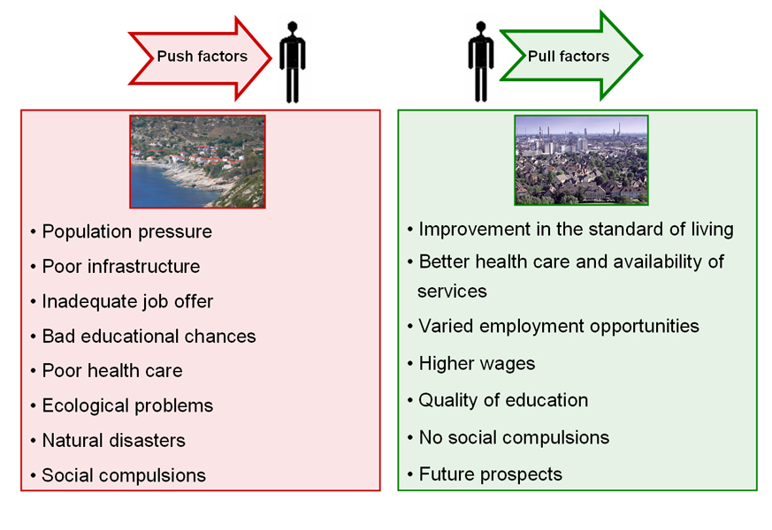
Concept
Notes:
Click to show the pull factors

Slide 8
Closure
Closure
What is the difference between an Migrant, Emigrant and an Immigrant?
Explain some of the push/pull factors that lead people to immigrate.

